Slide 1

Module 2 Regression Models

Slide 2
Module 2 Regression Models
Regression is defined as a statistical method that helps us to analyze and understand the relationship between two or more variables of interest.
It helps to understand which factors are important, which factors can be ignored, and how they are influencing each other.
have one dependent variable and one or more independent variables. Here we try to “regress” the value of the dependent variable “Y” with the help of the independent variables. In other words, we are trying to understand, how the value of ‘Y’ changes w.r.t change in ‘X’.

Slide 3
Regression Models
Dependent Variable: This is the variable that we are trying to understand or forecast.
Independent Variable: These are factors that influence the analysis or target variable and provide us with information regarding the relationship of the variables with the target variable.
A regression is a statistical technique that relates a dependent variable to one or more independent (explanatory) variables.
A regression model is able to show whether changes observed in the dependent variable are associated with changes in one or more of the explanatory variables.

Slide 4
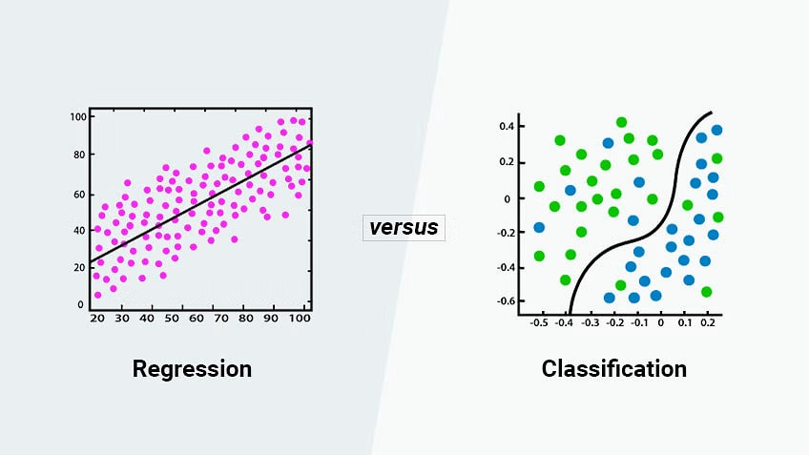
Regression Models

Slide 5
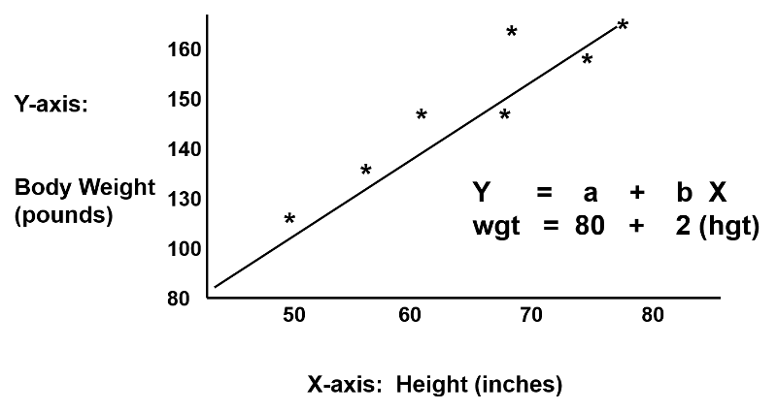
Regression Model: Example

Slide 6
SIMPLE Linear Regression
shows the linear relationship between the independent variable (X-axis) and the dependent variable (Y-axis)
an algorithm that provides a linear relationship between an independent variable and a dependent variable to predict the outcome of future events.
The independent variable is also the predictor or explanatory variable that remains unchanged due to the change in other variables. However, the dependent variable changes with fluctuations in the independent variable. The regression model predicts the value of the dependent variable, which is the response or outcome variable being analyzed or studied.
A sloped straight line represents the linear regression model.

Slide 7
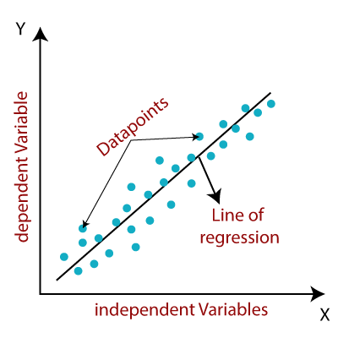
SIMPLE Linear Regression
X-axis = Independent variable
Y-axis = Output / dependent variable
Line of regression = Best fit line for a model

Slide 8
SIMPLE Linear Regression
Here, a line is plotted for the given data points that suitably fit all the issues. Hence, it is called the ‘best fit line.’
The goal of the linear regression algorithm is to find this best fit line.
best fit line means the error between predicted values and actual values should be minimized. The best fit line will have the least error.
Residuals: The distance between the actual value and predicted values is called residual. If the observed points are far from the regression line, then the residual will be high. If the scatter points are close to the regression line, then the residual will be small .

Slide 9

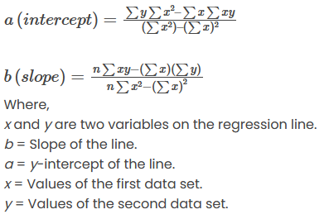
SIMPLE Linear Regression
Formula for linear regression equation is given by:
a and b are given by the following formulas:

Slide 10
here x is dependent variable (target)
y is independent variable
a is constatnt
b is the regression coefficient

Slide 11
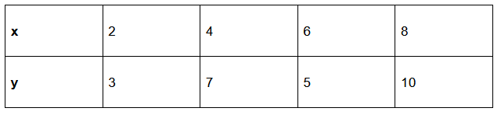
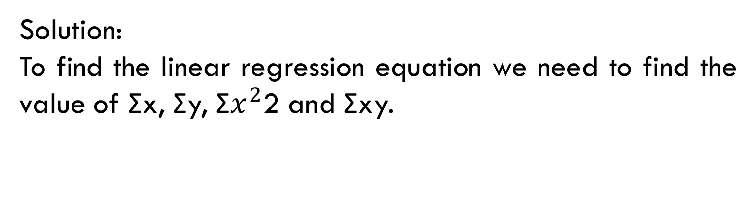
Example 1 :
Find a linear regression equation for the following two sets of data:
Solution:
To find the linear regression equation we need to find the value of Σx, Σy, Σ$x^{2}$2 and Σxy.
The formula of the linear equation is y=a+bx. Using the formula we will find the value of a and b

Slide 12
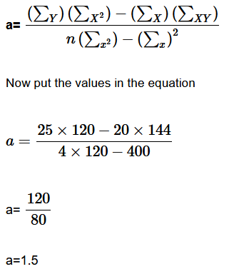
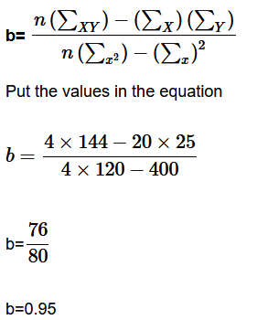
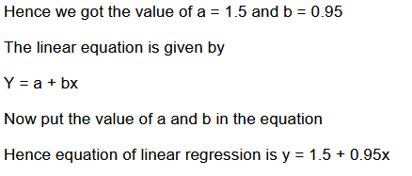

Slide 13
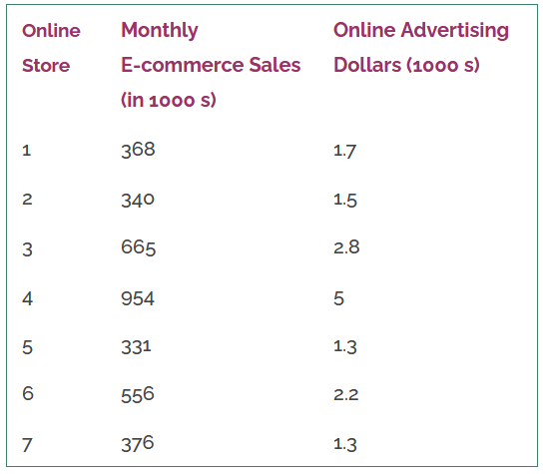
Example 2:

Slide 14
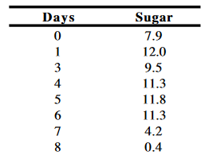
Example 3:
The data below show the sugar content of a fruit (SUGAR) for different numbers of days after picking (DAYS). Obtain the estimated regression line to predict sugar content based on the number of days the fruit is left on the tree.

Slide 15
Example 2:
Example 3:
Y= 125.8 + 171.5*X

Slide 16
Multiple Linear Regression (MLR)
predicts the value of a dependent variable (sometimes it is called as the outcome, target or criterion variable) on the basis of two or more independent variables (or sometimes, the predictor, explanatory or regressor variables)
Examples:
MLR can be used for predicting exam performance on the basis of revision time, lecture attendance, gender, or time anxiety.
identifying the relationship between the distance covered (dependent variable) by the cab driver and the age of the driver and years of experience (independent variables).

Slide 17
Multiple Linear Regression (MLR)
Multiple linear regression Formula
Y=b₀+ b₁ x₁+ b₂ x₂ +………+ b_{n}x_{n}
Where:
x₁ is one of the independent variables.
x₂ is the second independent variable.
x₃ is the third independent variable.
x_{n} is the kth independent variable.
b₀ is the Y-intercept, the value of Y when all the X’s are zero.
b_{i} is the net change in Y for each unit change in Xj, holding all other X’s constant.
j the subscript can assume values between 1 to k, which is the number of independent
variables.

Slide 18
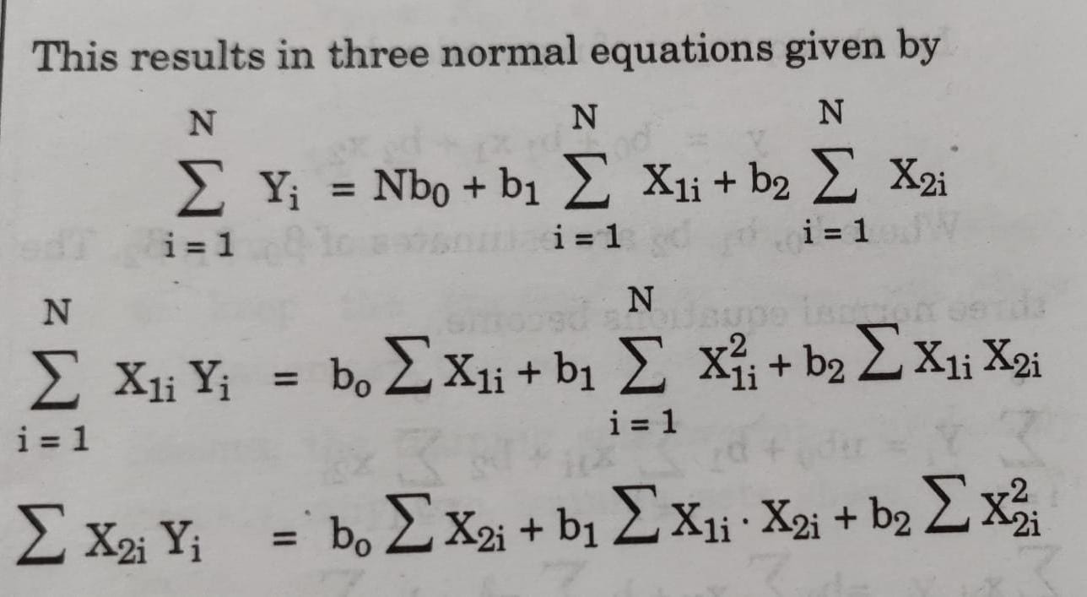

Slide 19
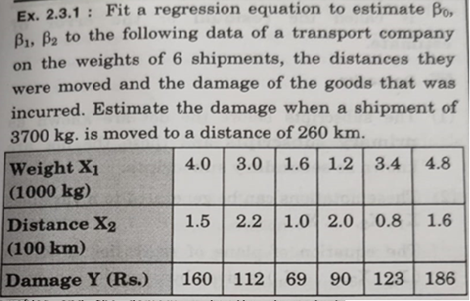
Multiple Linear Regression (MLR)
Example:

Slide 20
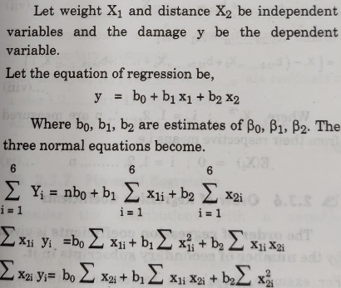

Slide 21
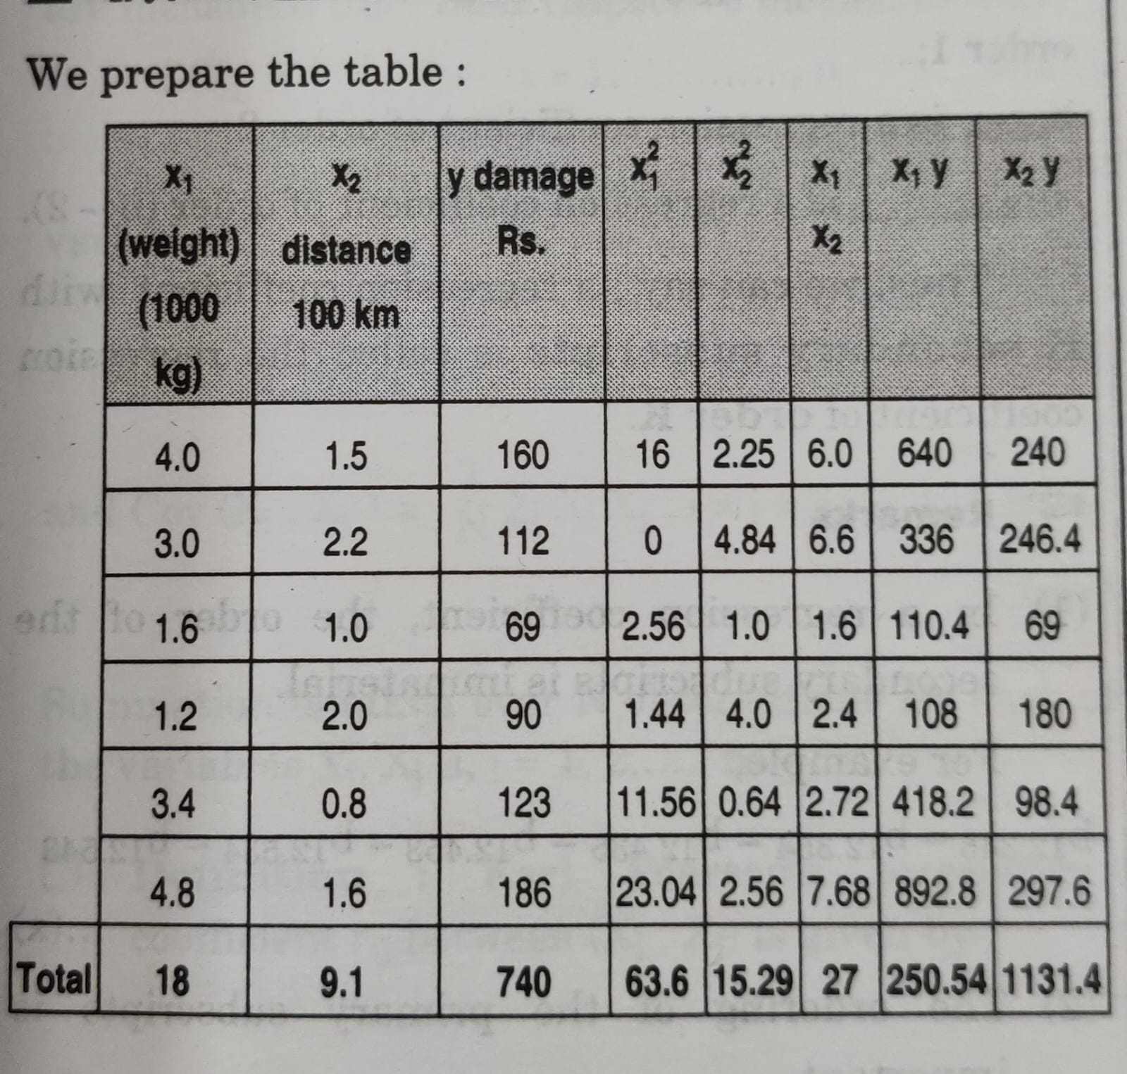

Slide 22
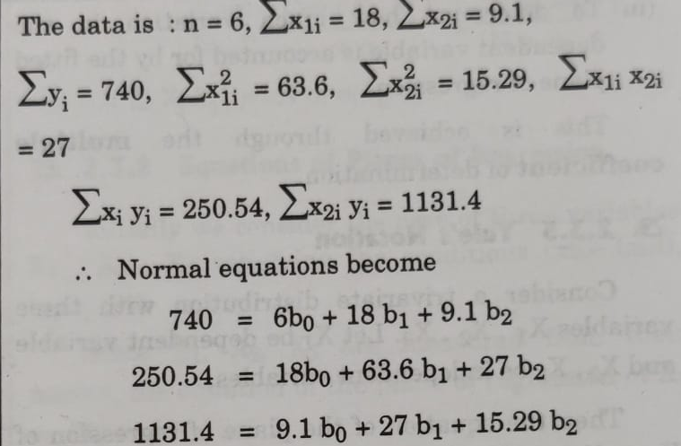

Slide 23
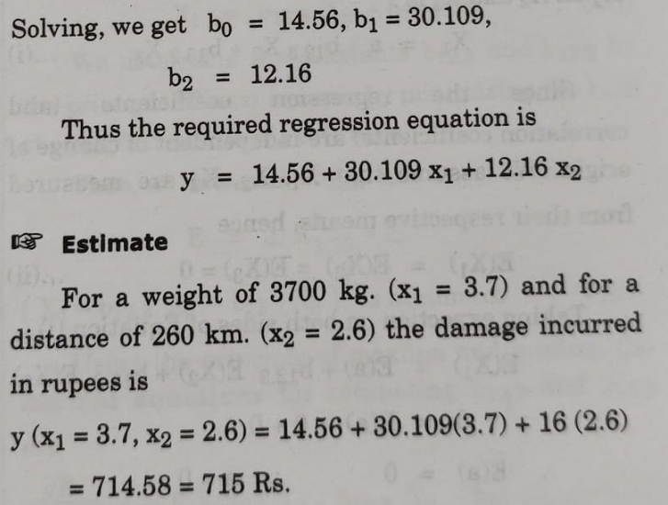

Slide 24
Logistic regression
comes under the Supervised Learning technique.
used for predicting the categorical dependent variable using a given set of independent variables.
predicts the output of a categorical dependent variable. Therefore the outcome must be a categorical or discrete value.
It can be either Yes or No, 0 or 1, true or False, etc. but instead of giving the exact value as 0 and 1, it gives the probabilistic values which lie between 0 and 1.

Slide 25
Logistic Regression is much similar to the Linear Regression except that how they are used.
Linear Regression is used for solving Regression problems, whereas Logistic regression is used for solving the classification problems.
In Logistic regression, instead of fitting a regression line, we fit an "S" shaped logistic function, which predicts two maximum values (0 or 1).
The curve from the logistic function indicates the likelihood of something such as whether the cells are cancerous or not.
Logistic Regression has the ability to provide probabilities and classify new data using continuous and discrete datasets.

Slide 26
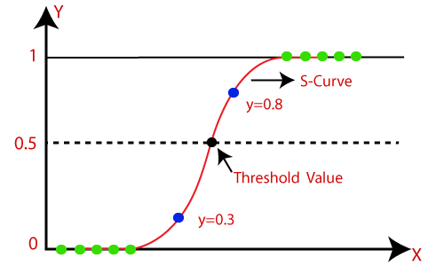
Logistic Regression can be used to classify the observations using different types of data and can easily determine the most effective variables used for the classification.
The below image is showing the logistic function:

Slide 27
Logistic Function (Sigmoid Function)
The sigmoid function is a mathematical function used to map the predicted values to probabilities.
It maps any real value into another value within a range of 0 and 1. The value of the logistic regression must be between 0 and 1, which cannot go beyond this limit, so it forms a curve like the “S” form.
The S-form curve is called the Sigmoid function or the logistic function.
In logistic regression, we use the concept of the threshold value, which defines the probability of either 0 or 1.
if the output of the sigmoid function (estimated probability) is greater than a predefined threshold on the graph, the model predicts that the instance belongs to that class. If the estimated probability is less than the predefined threshold, the model predicts that the instance does not belong to the class.
It maps any real value into another value within a range of 0 and 1.
For example, if the output of the sigmoid function is above 0.5, the output is considered as 1. On the other hand, if the output is less than 0.5, the output is classified as 0.

Slide 28

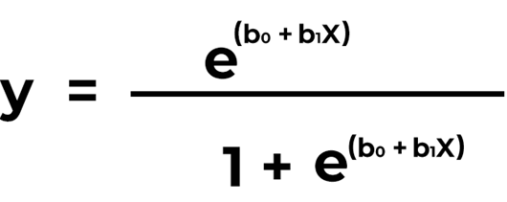
Logistic Regression Equation
The sigmoid function is referred to as an activation function for logistic regression and is defined as:
where,
e = base of natural logarithms
value = numerical value one wishes to transform
The following equation represents logistic regression:
where,
x = input value
y = predicted output
b0 = bias or intercept term
b1 = coefficient for input (x)

Slide 29
Assumptions for Logistic Regression:
The dependent variable must be categorical in nature.
The independent variable should not have multi-collinearity.

Slide 30
Types of Logistic Regression
On the basis of the categories, Logistic Regression can be classified into three types:
Binomial: In binomial Logistic regression, there can be only two possible types of the dependent variables, such as 0 or 1, Pass or Fail, etc.
Multinomial: In multinomial Logistic regression, there can be 3 or more possible unordered types of the dependent variable, such as “cat”, “dogs”, or “sheep”
Ordinal: In ordinal Logistic regression, there can be 3 or more possible ordered types of dependent variables, such as “low”, “Medium”, or “High”.

Slide 31
Sr.No | Linear Regresssion | Logistic Regression
1 | Linear regression is used to predict the continuous dependent variable using a given set of independent variables. | Logistic regression is used to predict the categorical dependent variable using a given set of independent variables.
2 | Linear regression is used for solving Regression problem. | It is used for solving classification problems.
3 | In this we predict the value of continuous variables | In this we predict values of categorical variables
4 | In this we find best fit line. | In this we find S-Curve .
5 | Least square estimation method is used for estimation of accuracy. | Maximum likelihood estimation method is used for Estimation of accuracy.
6 | The output must be continuous value, such as price, age, etc. | Output is must be categorical value such as 0 or 1, Yes or no, etc.
7 | It required linear relationship between dependent and independent variables. | It does not required linear relationship.
8 | There may be collinearity between the independent variables. | There should not be collinearity between independent variables.

Slide 32
Cross-Validation in Machine Learning
Cross validation is a technique used in machine learning to evaluate the performance of a model on unseen data.
It involves dividing the available data into multiple folds or subsets, using one of these folds as a validation set, and training the model on the remaining folds.
Cross-validation is a technique for validating the model efficiency by training it on the subset of input data and testing on previously unseen subset of the input data.
It is a technique to check how a statistical model generalizes to an independent dataset.
In machine learning, there is always the need to test the stability of the model. It means based only on the training dataset; we can't fit our model on the training dataset. For this purpose, we reserve a particular sample of the dataset, which was not part of the training dataset. After that, we test our model on that sample before deployment, and this complete process comes under cross-validation.

Slide 33
Cross-Validation in Machine Learning
What is cross-validation used for?
The main purpose of cross validation is to prevent overfitting, which occurs when a model is trained too well on the training data and performs poorly on new, unseen data. By evaluating the model on multiple validation sets, cross validation provides a more realistic estimate of the model’s generalization performance, i.e., its ability to perform well on new, unseen data.

Slide 34
Cross-Validation in Machine Learning
The basic steps of cross-validations are:
Reserve a subset of the dataset as a validation set.
Provide the training to the model using the training dataset.
Now, evaluate model performance using the validation set. If the model performs well with the validation set, perform the further step, else check for the issues.

Slide 35
Methods used for Cross-Validation
The common methods that are used for cross-validation:
Validation Set Approach
Leave-P-out cross-validation
Leave one out cross-validation
K-fold cross-validation
Stratified k-fold cross-validation

Slide 36
Validation Set Approach
divide input dataset into a training set and test or validation set in the validation set approach. Both the subsets are given 50% of the dataset.
It’s a simple and quick way to evaluate a model.
But it has one of the big disadvantages that we are just using a 50% dataset to train our model, so the model may miss out to capture important information of the dataset.
It also tends to give the underfitted model.

Slide 37
Leave-P-out cross-validation
In this approach, the p datasets are left out of the training data.
It means, if there are total n datapoints in the original input dataset, then n-p data points will be used as the training dataset and the p data points as the validation set.
This complete process is repeated for all the samples, and the average error is calculated to know the effectiveness of the model.
There is a disadvantage of this technique; that is, it can be computationally difficult for the large p.

Slide 38
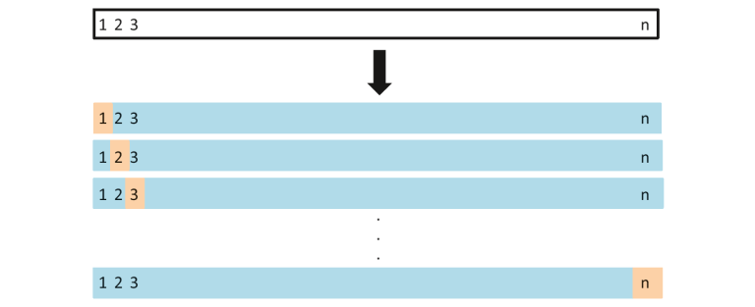
Leave one out cross-validation

Slide 39
Leave one out cross-validation
This method is similar to the leave-p-out cross-validation, but instead of p, we need to take 1 dataset out of training.
It means, in this approach, for each learning set, only one datapoint is reserved, and the remaining dataset is used to train the model.
This process repeats for each datapoint. Hence for n samples, we get n different training set and n test set.
It has the following features:
the bias is minimum as all the data points are used.
The process is executed for n times; hence execution time is high.
This approach leads to high variation in testing the effectiveness of the model as we iteratively check against one data point.

Slide 40
K-Fold Cross-Validation
K-fold cross-validation approach divides the input dataset into K groups of samples of equal sizes.
These samples are called folds.
For each learning set, the prediction function uses k-1 folds, and the rest of the folds are used for the test set.
This approach is a very popular CV approach because it is easy to understand, and the output is less biased than other methods.
The steps for k-fold cross-validation are:
Split the input dataset into K groups
For each group:
Take one group as the reserve or test data set.
Use remaining groups as the training dataset
Fit the model on the training set and evaluate the performance of the model using the test set.

Slide 41
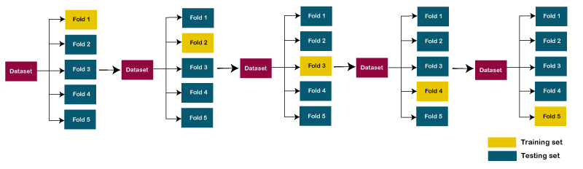
K-Fold Cross-Validation
Let's take an example of 5-folds cross-validation. So, the dataset is grouped into 5 folds. On 1st iteration, the first fold is reserved for test the model, and rest are used to train the model. On 2nd iteration, the second fold is used to test the model, and rest are used to train the model. This process will continue until each fold is not used for the test fold.

Slide 42
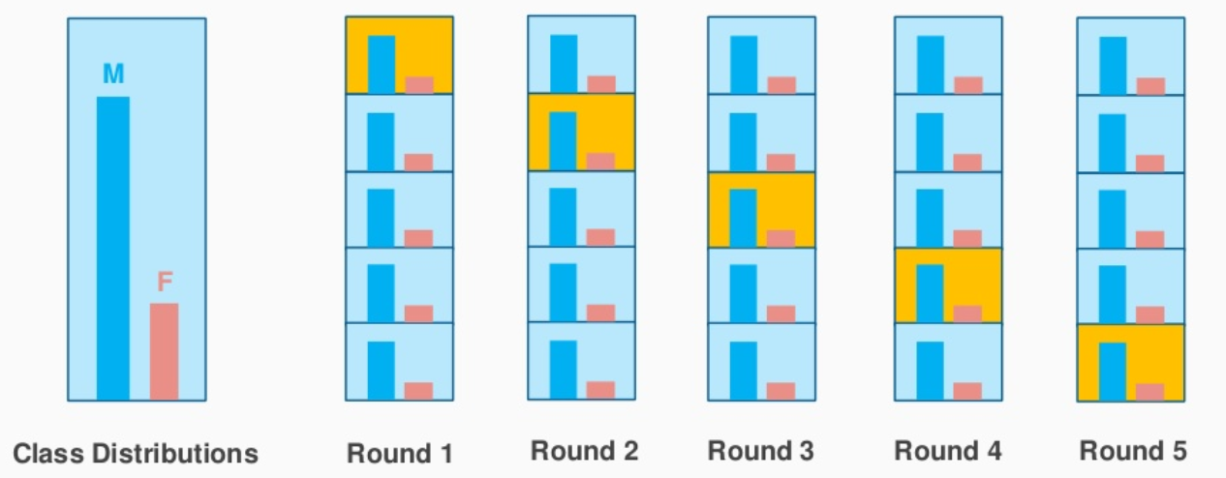
Stratified k-fold cross-validation
This technique is similar to k-fold cross-validation with some little changes.
This approach works on stratification concept, it is a process of rearranging the data to ensure that each fold or group is a good representative of the complete dataset.
To deal with the bias and variance, it is one of the best approaches.

Slide 43
Stepwise Regression
What Is Stepwise Regression?
Stepwise regression is the step-by-step iterative construction of a regression model that involves the selection of independent variables to be used in a final model.
It involves adding or removing potential explanatory variables in succession and testing for statistical significance after each iteration.
Stepwise regression is a method that iteratively examines the statistical significance of each independent variable in a linear regression model.

Slide 44
Stepwise Regression
Types of Stepwise Regression
Forward selection: begins with no variables in the model, tests each variable as it is added to the model, then keeps those that are deemed most statistically significant—repeating the process until the results are optimal.
Backward elimination: starts with a set of independent variables, deleting one at a time, then testing to see if the removed variable is statistically significant.
Bidirectional elimination: is a combination of the first two methods that test which variables should be included or excluded.

Slide 45
Stepwise Regression
Example
To understand energy usage at a factory using variables such as equipment run time, equipment age, staff size, temperatures outside, and time of year.
The model includes all of the variables—then each is removed, one at a time, to determine which is least statistically significant.
In the end, the model might show that time of year and temperatures are most significant, possibly suggesting the peak energy consumption at the factory is when air conditioner usage is at its highest.

